Slide 1
Dynamics 1: First Models
April 9, 2020

Slide 3
Practical Questions
What determines whether a disease will spread in a population and how many people will become infected?
What stops infectious diseases from infecting everyone?

Slide 4
Learning Objectives
Distinguish static from dynamic models of infectious diseases
Become familiar with the components and properties of a SIR model
Become comfortable with common terminology in models: effective contact rate, force of infection, incidence, recovery rate
Understand the basic reproductive number and its importance in infectious disease epidemics
Identify conditions under which an outbreak may occur and the role of herd immunity in preventing spread

Slide 5
About the math
Goal is to understand the connections between concepts
Show basic properties of models without rigorous derivations
Course is focused on more practical skills; problem sets and exams will not require mathematical proofs or any complex mathematical procedures
Seemingly complex observed patterns of infectious disease epidemics can be explained by simple models

Slide 6
Compartmental Models
Represent individuals according to health states
Here S, I, R = fractions of population in each state (S+I+R = N = 1)
S, I, R can be numbers of people (Keeling and Rohani use X, Y, Z for this)
Model changes in those states over time
Often analyzed by ordinary differential equations
S
I
R

Slide 7
The Catalytic Model
Susceptible (S)
Ever Infected (Z)
Assume infection risk (λ) is static, not driven by changes in population burden
Useful in sero-epidemiology
S
λS
Z

Slide 8
The Catalytic Model
Assume that 100% of individuals are born susceptible to disease
If the probability of infection is constant at 5% per year, what % of the population will have been infected by age 10?
λ= annual risk of infection
S
λS
Z

Slide 9
The Catalytic Model
S(0) = 1.00
S(1) = 1.00*(1-0.05) = 0.95
S(2) = 0.95*(1-0.05) = 0.9025
S(3) = 0.9025*(1-0.05)= 0.857
S(t) = S(0)*(1-p)^{t} = (1-p)^{t}
p=0.05
Z(t) = 1 – S(t)
Z(t) = 1 – S(0)*(1-p)^{t} = 1-(1-p)^{t}
Z(10) = 0.40

Slide 10




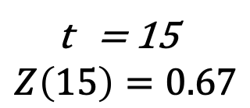
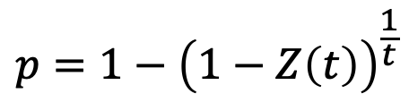
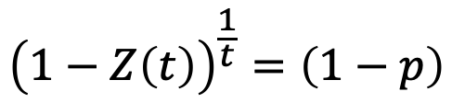
Uses for the Catalytic Model
A cross-sectional survey found that 2/3 of children were infected with TB by the age of 15 in one community in Western Cape, South Africa
What is the annual risk of infection?
$$Z\left(t\right)=1−\left(1−p\right)t$$
t = 15
$$Z\left(15\right)=0.67$$
$$1−Z\left(t\right)=\left(1−p\right)t$$
$${p=1−\left(1−0.67\right)}^{\frac{1}{15}}$$
$${\left(1−Z\left(t\right)\right)}^{\frac{1}{t}}=\left(1−p\right)$$
$$p=0.07$$
$${p=1−\left(1−Z\left(t\right)\right)}^{\frac{1}{t}}$$

Slide 11
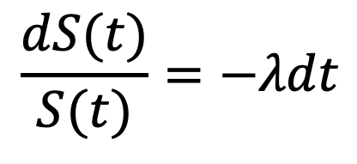
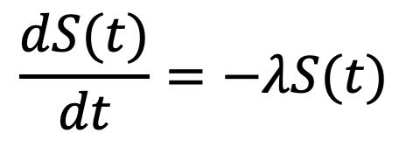
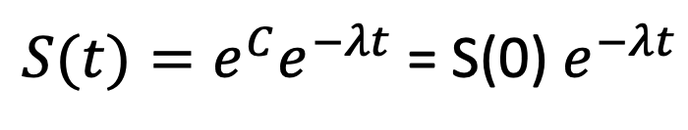

Continuous time catalytic models
S
λS
Z
$$\frac{dS(t)}{dt}=−λS(t)$$
$$\frac{dS(t)}{S(t)}=−λdt$$
$$\ln\left(S\left(t\right)\right)=−λt+C$$
$S(t)=e^{C}e^{−λt}$= S(0) $e^{−λt}$

Slide 12
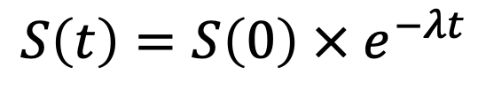

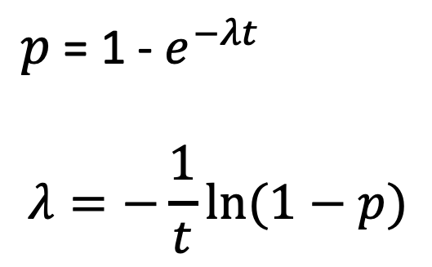
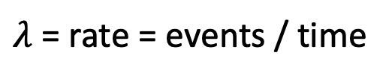
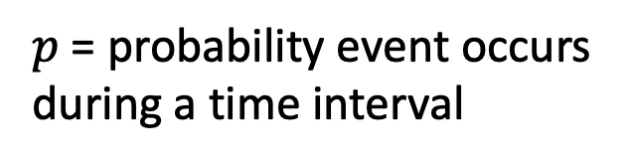
Rates versus Probabilities
$$S\left(t\right)=S\left(0\right)×\left(1−p\right)t$$
$p$= probability event occurs during a time interval
$$S\left(t\right)=S\left(0\right) × e^{−λt}$$
$λ$ = rate = events / time
$p$ = 1 - $e^{−λt}$
$$λ=−\frac{1}{t}ln⁡(1−p)$$

Slide 13
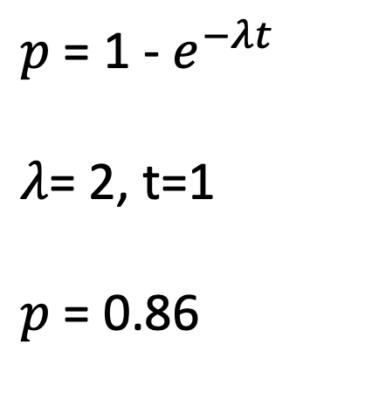
Rates versus Probabilities
Suppose on average, individuals have 2 upper respiratory infections per year. What is the probability that an individual will have at least 1 respiratory infection in a given year?
$p$ = 1 - $e^{−λt}$
$λ$= 2, t=1
$p$ = 0.86

Slide 14
Summary: Catalytic Models
Can be useful for relating cumulative disease risk over time with infection rates
Can be adapted to time- or age-varying rates
Don’t account for dynamic changes in infection rates that occur as the proportion of infected individuals changes
Static models

Slide 15
Dynamic Compartmental Models

Slide 16
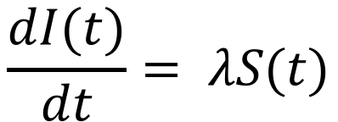
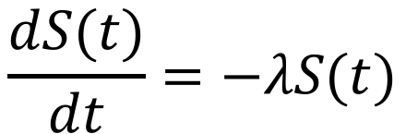
Brief Intro to Differential Equations
$$\frac{dS(t)}{dt}=−λS(t)$$
S
λS
I
$$\frac{dI(t)}{dt}= λS(t)$$
Have to specify initial conditions (S(0) and I(0))
If rate is negative, compartment is declining, if positive, increasing
The rates on the right side must add up to 0.
These are a series of ordinary differential equations (ODE)

Slide 17
Dynamic Compartmental Models
Now assume that the rate of infection depends on infection, it is changing (dynamic)
λ(t) = βI(t)
S
λS
I
S
βSI
I
Catalytic (Static) Model
Dynamic Model

Slide 18
Force of Infection
The force of infection (λ) is the rate at which susceptible individuals are infected.
It is a function of the proportion (or number) of infected individuals and the rate at which they infect others
We call this the effective contact rate (β)
λ(t) = βI(t)

Slide 19

Effective Contact Rate (ECR)
The ECR is the number of infections generated by an infectious person, over a defined period of time (i.e. daily, monthly, yearly) to a susceptible population
ECR is sometimes broken down into multiple components, for example:
$$β=k∗p$$
Where:
k = number of contacts per unit time
p= probability of infection for each contact

Slide 20
Effective contact rate example
Suppose I have measles and contact 10 people per day, and 90% of those exposed to me are infected
What is my effective contact rate?
Per week?

Slide 21
Force of Infection vs Incidence
What is the difference between the force of infection and incidence?
Force of infection = λ(t) = βI(t)
S
βSI
I

Slide 22
Force of Infection, Incidence, Prevalence
Force of infection = βI(t)
Incidence = βS(t)I(t)
Prevalence = I(t)
S
βSI
I

Slide 23
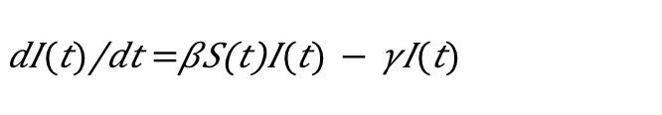
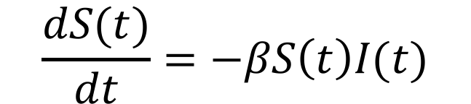
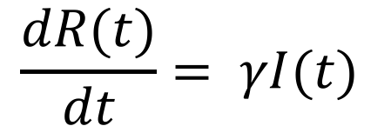
The SIR Model
S
βSI
I
γΙ
R
infection
recovery
$$\frac{dS(t)}{dt}=−βS\left(t\right)I(t)$$
$\frac{dI(t)}{dt}=βS\left(t\right)I(t)$ $−$ $γI(t)$
$$\frac{dR(t)}{dt}= γI(t)$$
From here on out, I’ll drop the “(t)”

Slide 24
On Rates
The inverse of a rate is the average time until the event occurs
For example, suppose a train stops 4 times per hour
What is the average time between stops?
In epidemiologic models, we often measure the average time between events, and then convert to rates.
Suppose the average duration of influenza infection is 1 week, what is the daily rate of recovery?
What is the yearly rate of recovery?

Slide 25
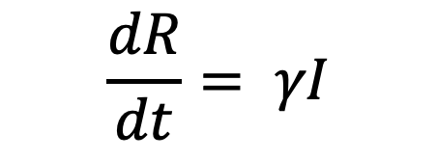

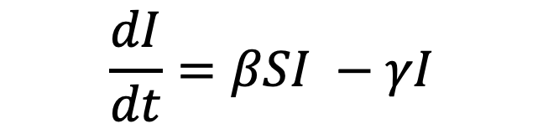
Model Behaviors
S
βSI
I
γΙ
R
infection
recovery
$$\frac{dS}{dt}=−βSI$$
$$\frac{dI}{dt}=βSI −γI$$
$$\frac{dR}{dt}= γI$$

Slide 26
“Solving” SIR Models
We want to solve for S, I and R over time
Because of the S x I term, there is no exact analytical solution
Numerical methods using discrete time algorithms

Slide 27
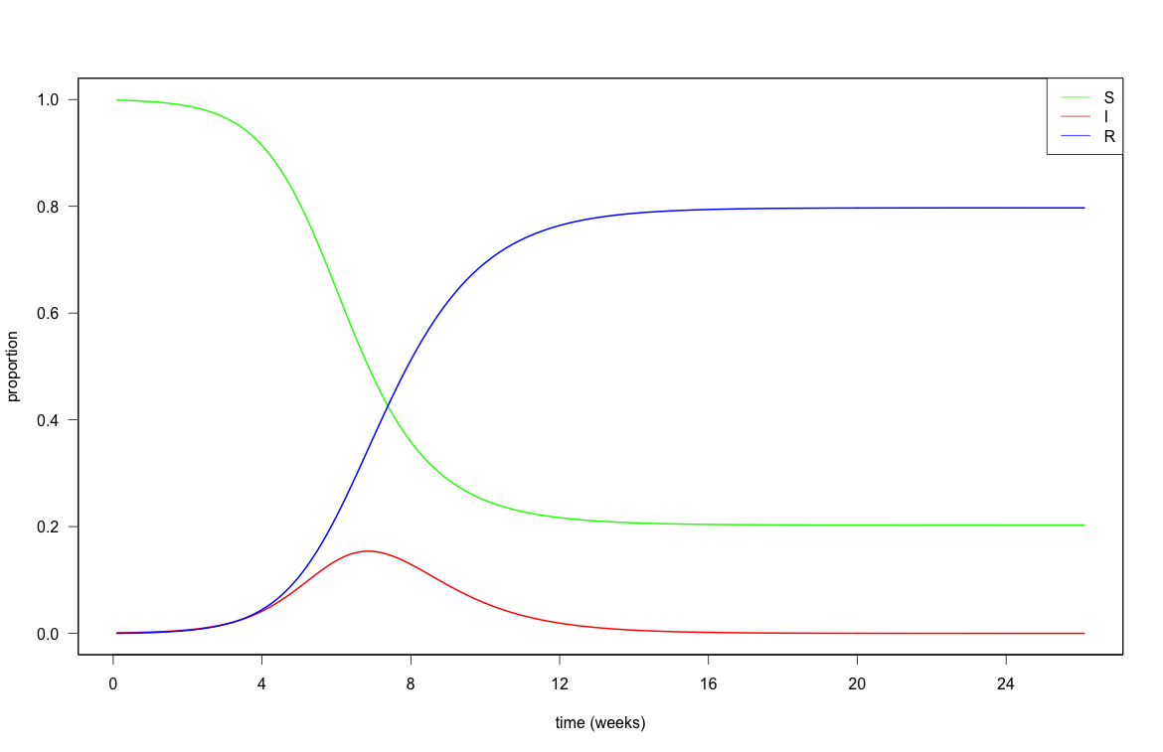
S(0)=0.999; I(0)=0.001; β=2; γ=1

Slide 28
Questions we can ask of this model
Under what conditions can an epidemic occur?
Under what conditions can an epidemic be prevented?
What will be the total size of the epidemic?

Slide 29
Under what conditions can an epidemic occur?
Scenario 1: S(0) = 1, I(0) = 0
Scenario 2: S(0) = 0.99, I(0)=0.01
Scenario 3: S(0) = 0.01, I(0) =0.01, R(0)=0.98

Slide 30
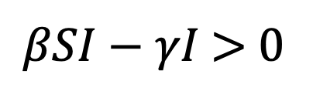
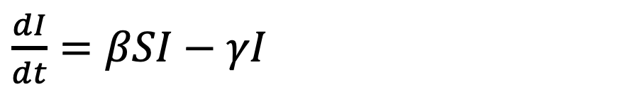
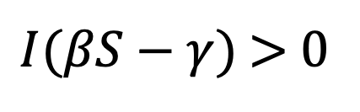
Under what conditions can an epidemic occur?
Scenario 1: S(0) = 1, I(0) = 0
$\frac{dI}{dt}=βSI$ $−$ $γI$
$βSI$ $−$ $γI$ > 0
$I(βS$ $−$ $γ)$ > 0
No epidemic if I = 0

Slide 31
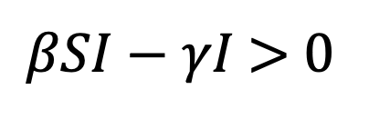
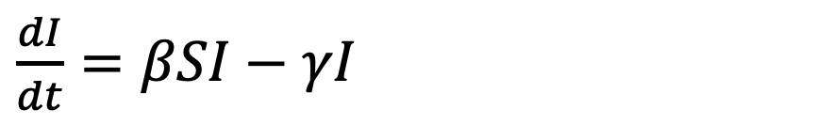
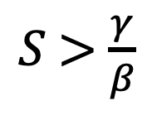
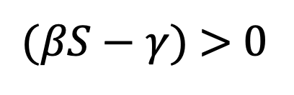
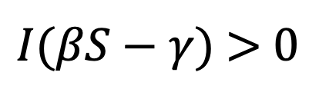
Under what conditions can an epidemic occur?
Scenario 2: S(0) = 0.99, I(0)=0.01
$\frac{dI}{dt}=βSI$ $−$ $γI$
$βSI$ $−$ $γI$ > 0
$I(βS$ $−$ $γ)$ > 0
$(βS$ $−$ $γ)$ > 0
$S$ > $\frac{γ}{β}$
For epidemic to start, S(0) > γ/β and I(0) > 0

Slide 32
Under what conditions can an epidemic occur?
Scenario 3: S(0) = 0.01, I(0)=0.01, R(0)=0.98
$\frac{dI}{dt}=βSI$ $−$ $γI$
$βSI$ $−$ $γI$ > 0
$I(βS$ $−$ $γ)$ > 0
$(βS$ $−$ $γ)$ > 0
$S$ > $\frac{γ}{β}$
For epidemic to start, S(0) > γ/β and I(0) > 0

Slide 33
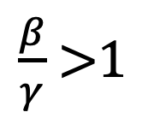
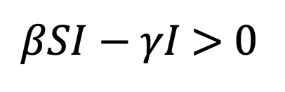
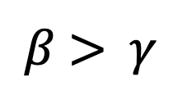
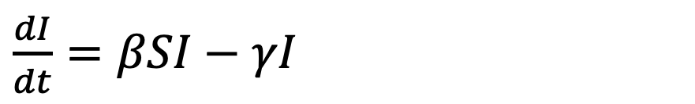
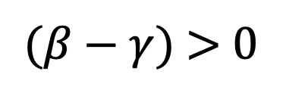
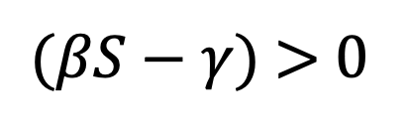
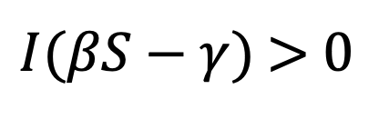
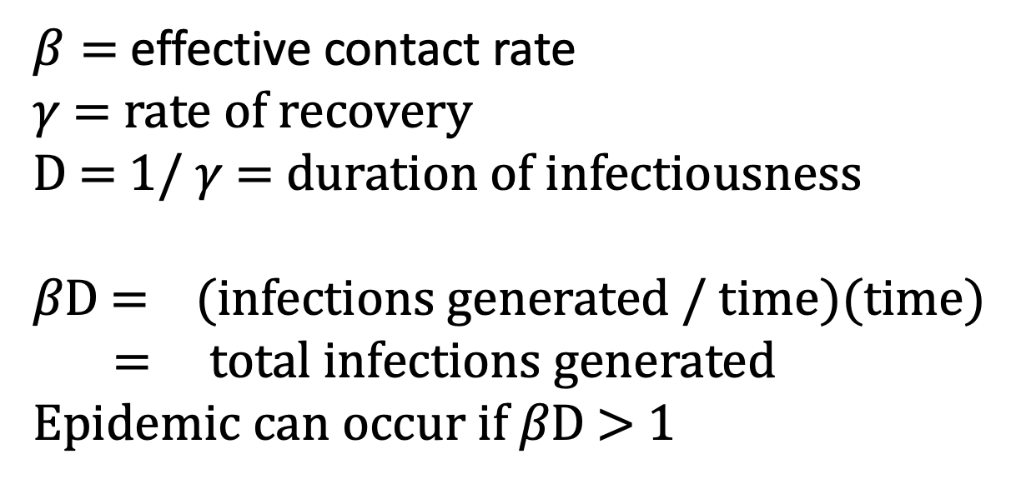
Under what conditions can an epidemic occur?
$\frac{dI}{dt}=βSI$ $−$ $γI$
$βSI$ $−$ $γI$ > 0
$I(βS$ $−$ $γ)$ > 0
$β=$ effective contact rate
$γ$ = rate of recovery
D = 1/ $γ$ = duration of infectiousness
$β\text{D}$ = (infections generated / time)(time)
= total infections generated
Epidemic can occur if $β\text{D}$ > 1
$(βS$ $−$ $γ)$ > 0
If S(0) = 1
$(β$ $−$ $γ)$ > 0
$β$ > $γ$
$\frac{β}{γ}$ >1

Slide 34
Basic Reproductive Number
The basic reproductive number (R₀) is the average number of infectious individuals generated by a single infectious individual in a fully susceptible population
In the SIR model, R₀ = β/γ or βD, where D= duration of infectiousness
If >1, an epidemic can occur
For an epidemic to begin, the susceptible population has to be greater than 1/R₀

Slide 35
Under what conditions can an epidemic occur?
$\frac{dI}{dt}=βSI$ $−$ $γI$
$βSI$ $−$ $γI$ > 0
$I(βS$ $−$ $γ)$ > 0
$(βS$ $−$ $γ)$ > 0
$S$ > $\frac{γ}{β}$
For epidemic to start, S(0) > γ/β and I(0) > 0

Slide 36
R₀ for various diseases
Disease | Estimated R0
Tuberculosis | 1-3
Influenza | 1.5-4
Rubella | 6-7
Chickenpox | 10-12
Measles | 16-25

Slide 37
Basic Reproductive Number and Vaccine Critical Proportion
P_{I}: proportion immunized
S = 1 – P_{I}
S(0) > 1/R₀
1-P_{I} > 1/R₀
P_{I} < 1-1/R₀
P_{c}: critical proportion to immunize to avert epidemic
P_{c} > 1-1/R₀
What is the critical proportion to immunize for Measles? (R₀=20)

Slide 38
Why does an epidemic decline?

Slide 39
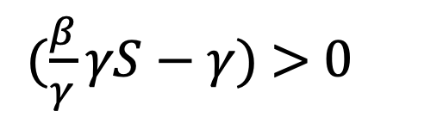
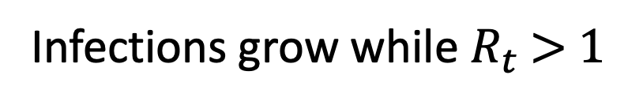
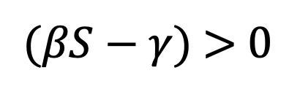
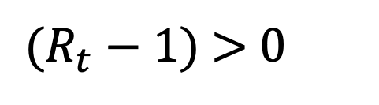
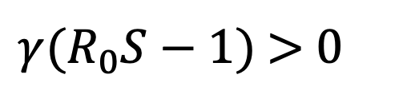
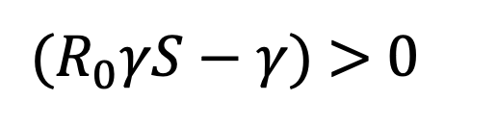
Basic vs Effective Reproductive Number
Effective Reproductive Number (R_{e}): number of infections generated by average infectious person during epidemic
R_{t} : Effective reproductive number at time t
R_{t} = R₀*S_{t}
$(βS$ $−$ $γ)$ > 0
$(\frac{β}{γ}γS$ $−$ $γ)$ > 0
$(R_{0}γS$ $−$ $γ)$ > 0
$γ(R_{0}S$ $−$ 1$)$ > 0
$(R_{t}$ $−$ 1$)$ > 0
Infections grow while $R_{t}$ > 1

Slide 41
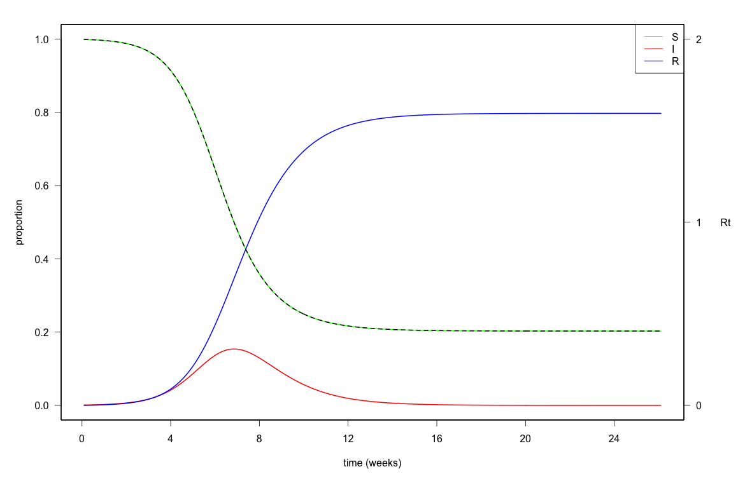

Slide 42
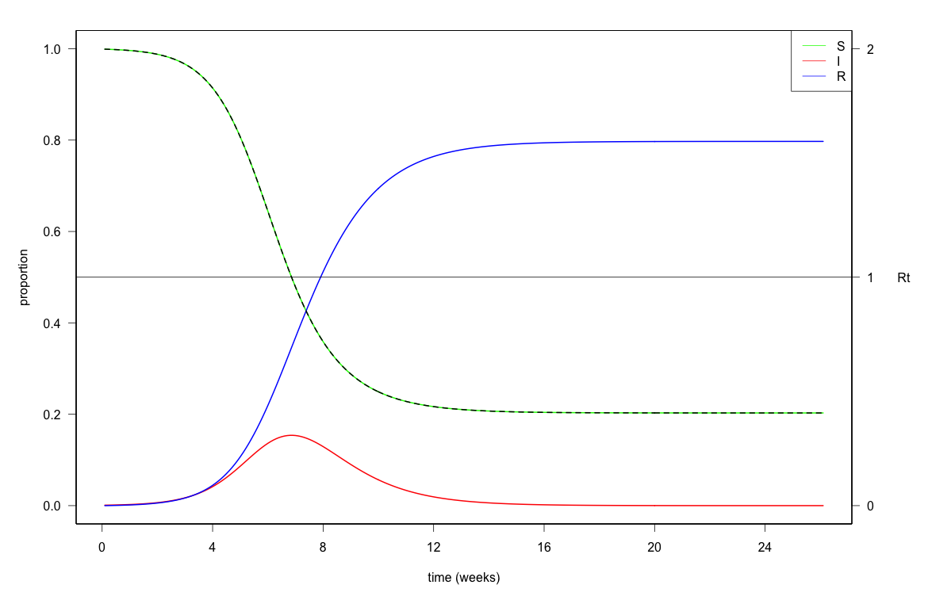

Slide 43
Herd Immunity
Susceptible
Infectious
Immune

Slide 44
The susceptible fraction is the critical limiting factor to the start and decline of an epidemic

Slide 45
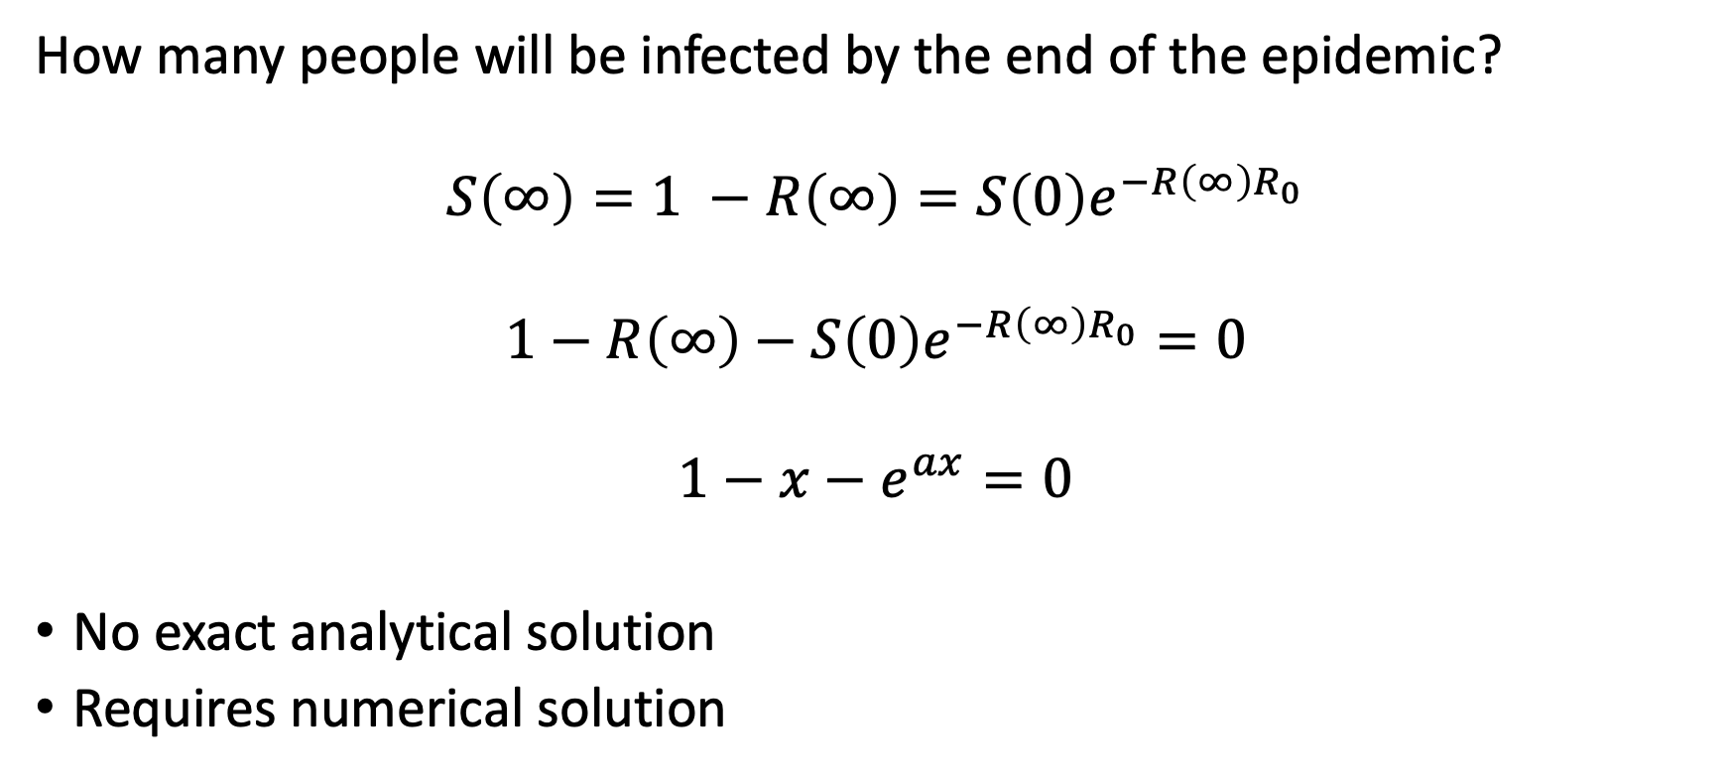
Final Epidemic Size
How many people will be infected by the end of the epidemic?
$$S\left(∞\right)=1 −R\left(∞\right)=S\left(0\right)e^{−R\left(∞\right)R_{0}}$$
$$1−R\left(∞\right)−S\left(0\right)e^{−R\left(∞\right)R_{0}}=0$$
$$1−x−e^{ax}=0$$
No exact analytical solution
Requires numerical solution

Slide 46
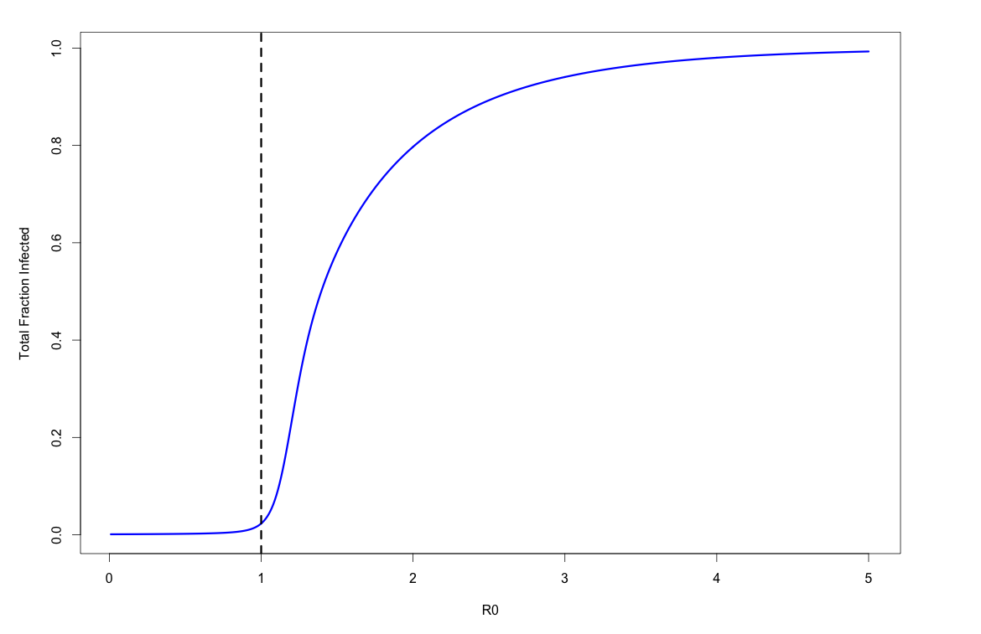

Slide 47
SIR Model Summary
Using a simple model with 3 equations and 2 parameters, we can:
characterize epidemics
understand conditions required to have an epidemic
predict when they will peak and decline
quantify vaccine coverage needed to prevent them
project how many people will be affected

Slide 48
Frequency vs density dependence
Frequency dependence(“true mass action”): number of effective contacts is unchanged as population grows
Density dependence (“pseudo mass action”): number of effective contacts scales with population density
Density Dependent
Plant diseases
Animal diseases
Frequency Dependent
Respiratory Infections
Sexually Transmitted Infections

Slide 49
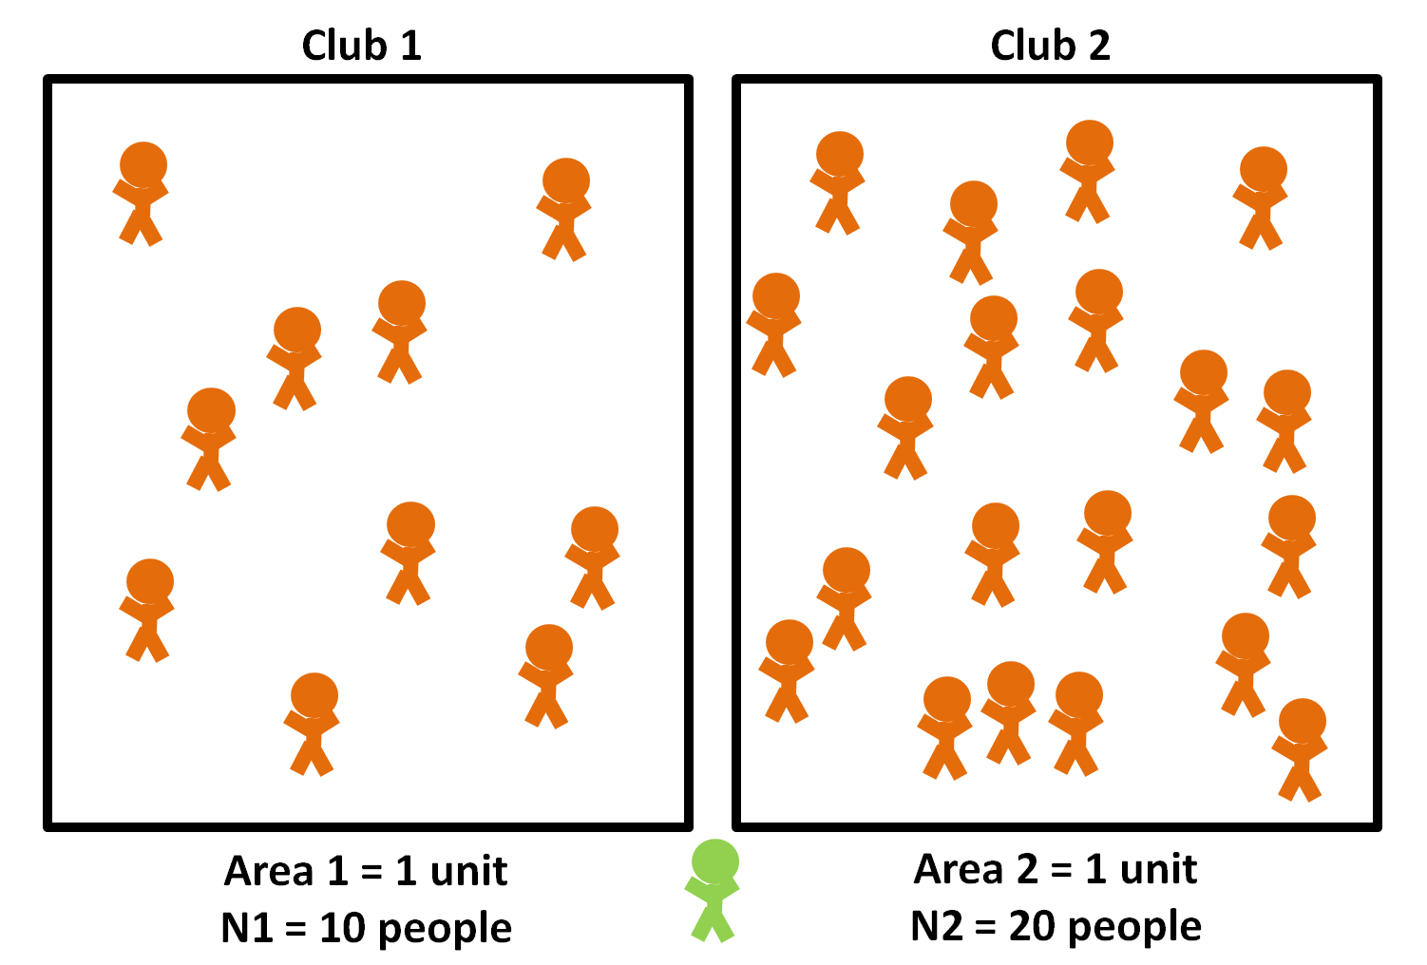
Frequency vs density dependence
parasiteecology.wordpress.com

Slide 50
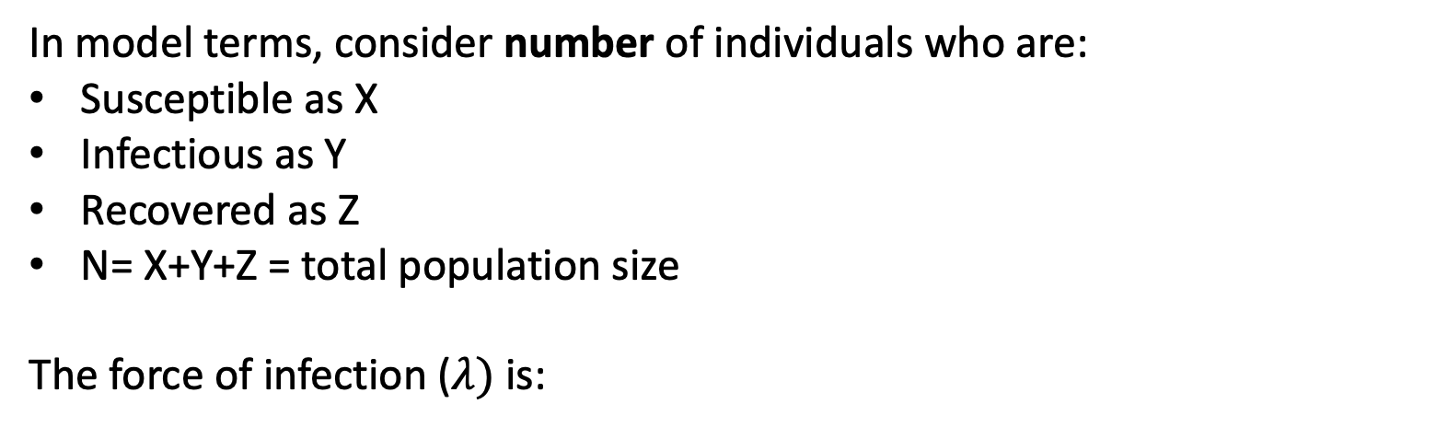
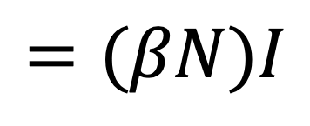
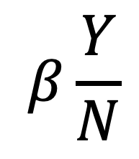
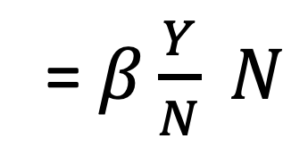


Frequency vs Density Dependence
In model terms, consider number of individuals who are:
Susceptible as X
Infectious as Y
Recovered as Z
N= X+Y+Z = total population size
The force of infection ($λ)$ is:
$$β\frac{Y}{N}$$
$$βY$$
= $β\frac{Y}{N} N$
$$=(βN)I$$
= $βI$
Frequency dependent
Density dependent

Slide 51
Do these models realistically describe outbreaks?

Slide 52

SIR Model of English Boarding School

Slide 53



SIR Model of English Boarding School
$β$=1.66/day
$$D=1/γ=2.2 days$$

Slide 54
Concepts Review
The effective contact rate is the rate at which infectious individuals infect susceptible individuals
R₀ is the average number of infectious individuals generated by a single infectious individual in a fully susceptible population
If R₀ < 1, an epidemic cannot be sustained; when R_{t} < 1, epidemic declines
The critical threshold for vaccination is the level above which outbreaks can’t occur (1-1/R₀)
The fraction of susceptible individuals is the limiting factor in epidemics, dictates whether they start, and when they end

